Slide 1
Fundamentals of Machine Learning Engineering with Pytorch
COLAB MACHINE LEARNING COMMUNITY
Presented by
Chukwuemeka James [AI/ML Engr. || Data Scientist]

Slide 2
To explore the fundamentals of Machine Learning Engineering through the lens of Deep learning and Pytorch, a framework that empowers you to build the next generation of intelligent systems.
What is Machine Learning Engineering?
Building, deploying, and maintaining machine learning models in production.
What is PyTorch?
Pytorch is an open source machine learning and deep learning frame work.
What is Deep learning?
Deep learning is a subset of machine learning that focuses on using neural networks with many layers (hence the term "deep") to automatically learn and extract features from large datasets. Unlike traditional machine learning, which often requires manual feature extraction, deep learning models can learn these features directly from raw data, making them highly effective for complex tasks such as image recognition, speech processing, and natural language understanding.
What can PyTorch be used for?
PyTorch allows you to manipulate and process data and write machine learning algorithms using python code.
Objective

Slide 3
1. PyTorch installation & Introduction to tensors 2. Creating Tensors 3. Getting information from Tensors 4. Manipulating tensors
Tensors
TO install Pytorch visit: https://pytorch.org/get-started/locally/
Tensors are Multi-dimensional arrays similar to NumPy arrays but with GPU acceleration.
Tensors are the building block of machine learning and deep learning.
Tensors can be used to represent data in the form of images, words, or table of numbers.
Things to be covered

Slide 4
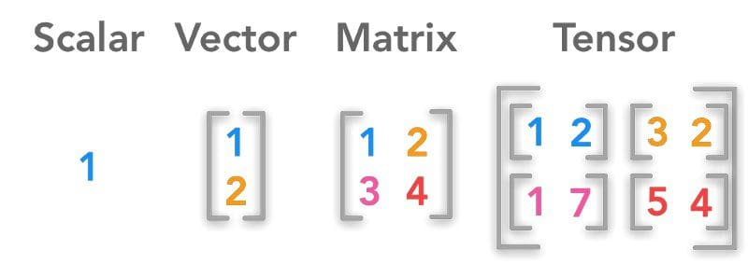
Tensors can be in any of the following form 1. Scaler 2. Vector 3. Matrix 4. Tensor
Introduction to tensors

Slide 5
Scalar: A scalar is a single numerical value. It is a quantity with magnitude but no direction. In terms of dimensions, a scalar is a 0-dimensional entity.
Vector: A vector is an ordered list of numbers. It has both magnitude and direction and is 1-dimensional. Each number in a vector is called a component or an element.
Matrix: A matrix is a 2-dimensional array of numbers, consisting of rows and columns. A matrix can store a collection of vectors in a structured way.
Tensor: A tensor is a generalization of scalars, vectors, and matrices to higher dimensions. While a vector is 1D and a matrix is 2D, a tensor can have any number of dimensions (also called "rank" or "order"). A tensor of rank 3 or higher represents more complex structures.

